Slide 1

Notes:
Title

Slide 2
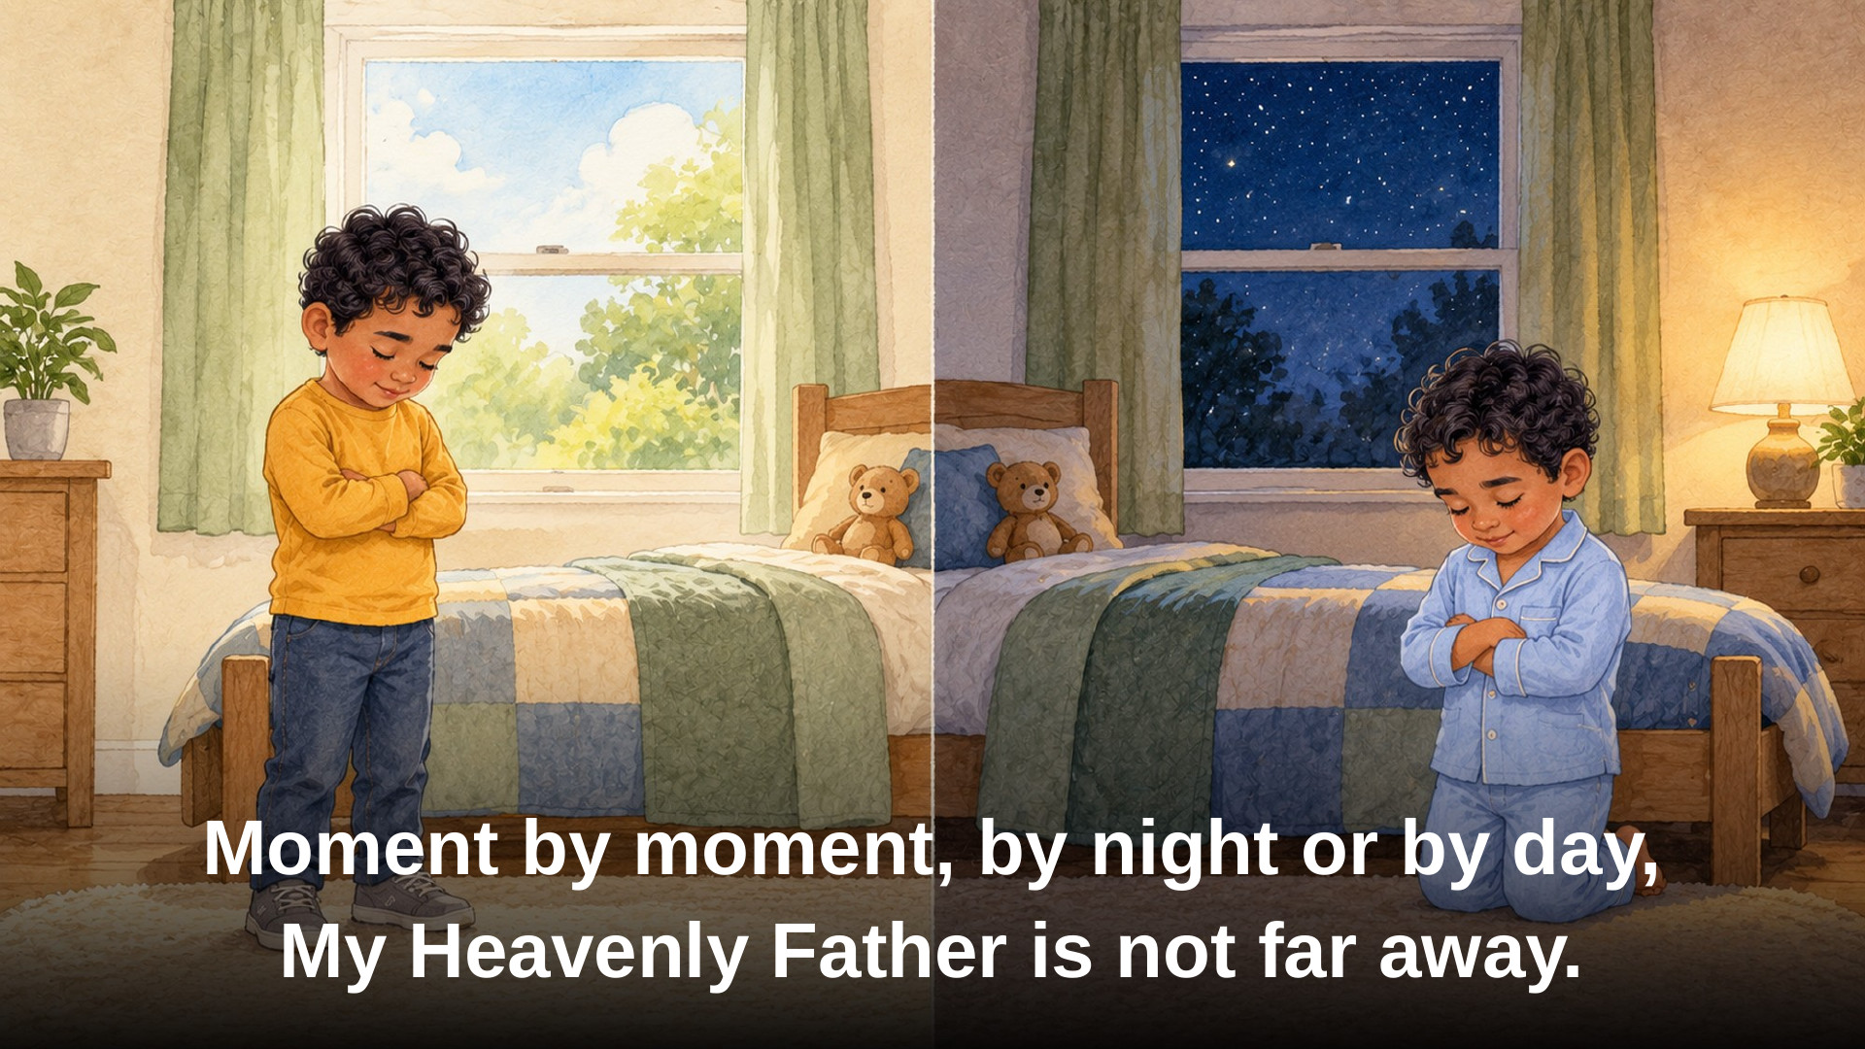
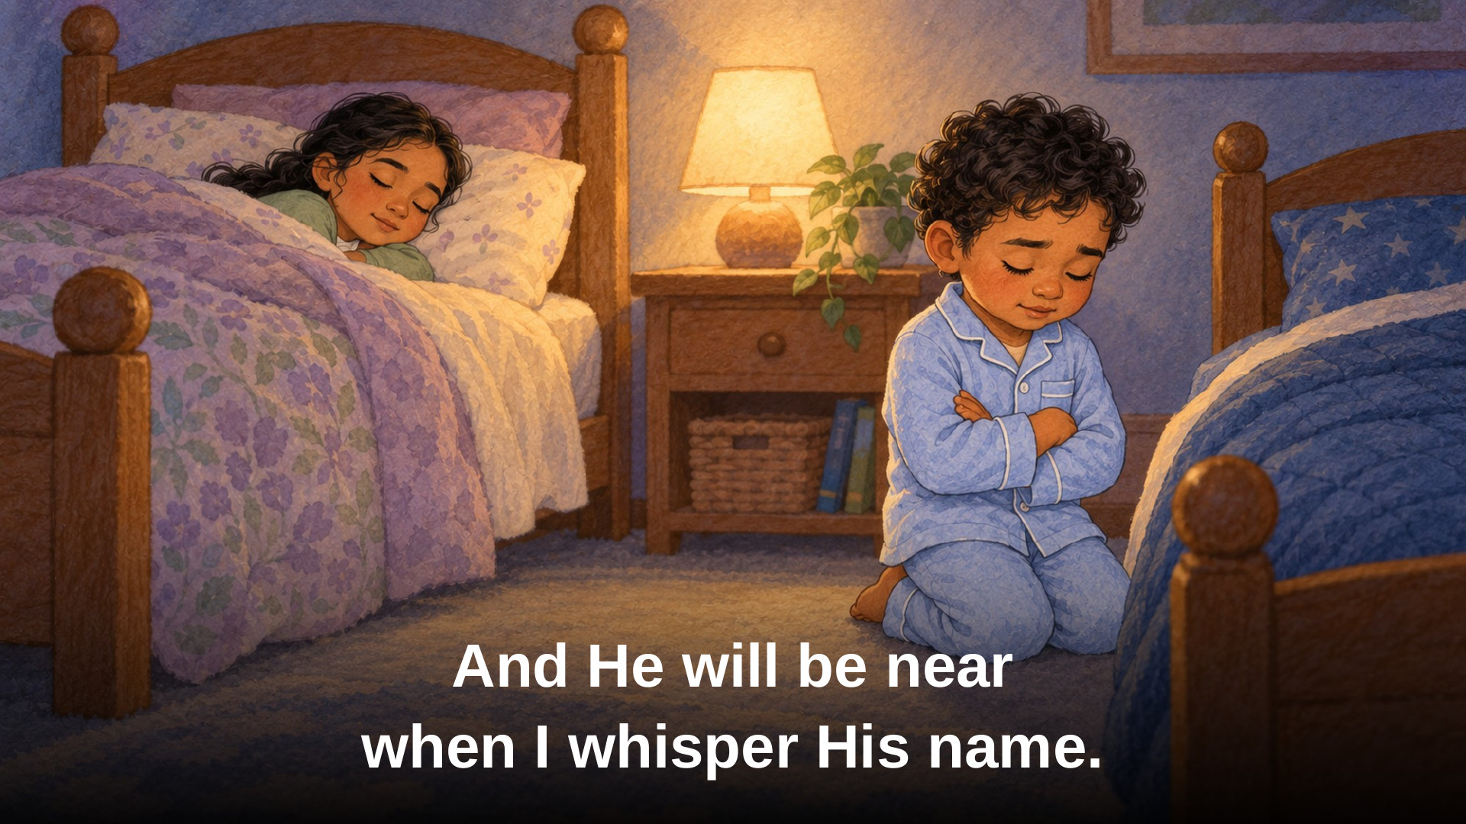

Notes:
Verse 1

Slide 3



Notes:
Verse 2

Slide 4
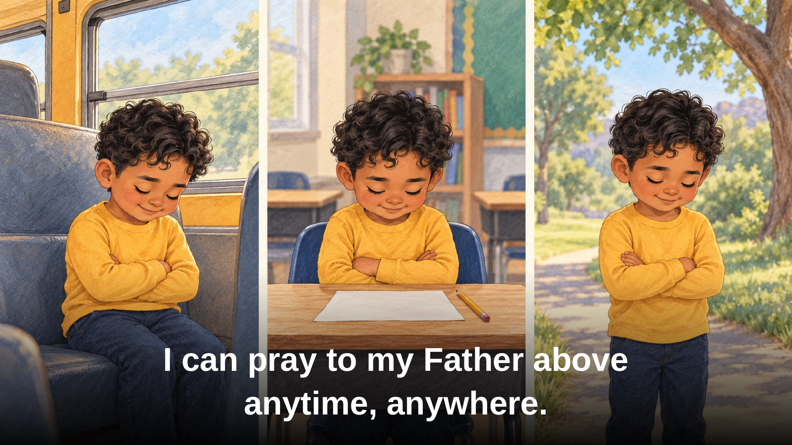

Notes:
Bridge

Slide 5



Notes:
Verse 3

